Slide 1
HTML5 Layout
Notes:
1

Slide 2
What will be covered in this section
HTML5 is introducing a new set of elements that help define the structure of a page
HTML5 layout elements and their uses
How they offer helpful alternatives to the <div> element
How old browsers understand new elements
Styling HTML5 layout elements with CSS
Notes:
2

Slide 3
Traditional HTML Layouts
For a long time, web page authors used <div> elements to group together related elements on the page:
  Header
  An article
  Footer
  sidebar
class or id attributes were used to indicate the role of the <div> element in the structure of the page.
See example on next slide
Notes:
3

Slide 4
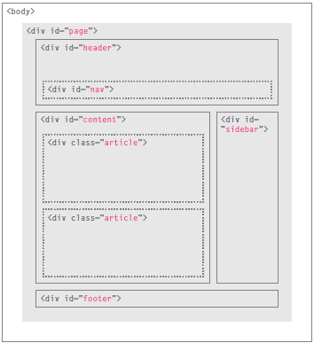
Traditional HTML Layouts
Notes:
4

Slide 5
New HTML5 Layout Elements
HTML5 introduces a new set of elements that allow you to divide up the parts of a page
The names of these elements indicate the kind of content you will find in them.
The example on the next slide has exactly the same structure as seen on the previous page. However, many of the <div> elements have been replaced by new HTML5 layout elements.
For example, the header sits inside a new <header> element, the navigation in a <nav> element, and the articles are in individual <article> elements
Notes:
5

Slide 6
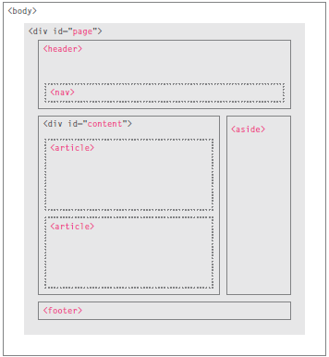
New HTML5 Layout Elements
Notes:
6

Slide 7
Headers and Footers
The <header> and <footer> elements can be used for:
  The main header or footer that appears at the top or bottom of every page on the site.
  A header or footer for an individual <article> or <section> within the page.
In this example below, the <header> element used to contain the site name and the main navigation. The <footer> element contains copyright information, along with links to the privacy policy and terms and conditions.
Each individual <article> and <section> element can also have its own <header> and <footer> elements
Notes:
7

Slide 8
Navigation, Articles
The <nav> element is used to contain the major navigational blocks on the site such as the primary site navigation
The <article> element acts as a container for any section of a page that could stand alone
This could be an individual article or blog entry, a comment or forum post, or any other independent piece of content.
If a page contains several articles (or even summaries of several articles), then each individual article would live inside its own <article> element
The <article> elements can even be nested
Notes:
8

Slide 9
ASIDE
The <aside> element has two purposes, depending on whether it is inside an <article> element or not
When the <aside> element is used inside an <article> element, it should contain information that is related to the article but not essential to its overall meaning. For example, a pullquote or glossary
When the <aside> element is used outside of an <article> element, it acts as a container for content that is related to the entire page
For example, it might contain links to other sections of the site, a list of recent posts, a search box, or recent tweets by the author
Notes:
9

Slide 10
Sections
The <section> element groups related content together, and typically each section would have its own heading
For example, on a homepage there may be several <section> elements to contain different sections of the page, such as latest news, top products, and newsletter signup
Because the <section> element groups related items together, it may contain several distinct <article> elements that have a common theme or purpose
The <section> element should not be used as a wrapper for the entire page. If you want a containing element for the entire page, that job is still best left to the <div> element.
Notes:
10

Slide 11
Heading Groups
The purpose of the <hgroup> element is to group together a set of one or more <h1> through <h6> elements so that they are treated as one single heading
For example, the <hgroup> element could be used to contain both a title inside an <h2> element and a subtitle within an <h3> element.
it is useful to group together the primary heading and the subheading
Notes:
11

Slide 12
Figures
You already met the <figure> element when we looked at images
It can be used to contain any content that is referenced from the main flow of an article
Examples of usage include:
  Images
  Videos
  Graphs
  Diagrams
  Code samples
  Text that supports the main
  body of an article
The <figure> element should also contain a <figcaption> element which provides a text decription for the content of the <figure> element
Notes:
12

Slide 13
Sectioning Elements <div>
The <div> element will remain an important way to group together related elements
you should not be using these new elements that you have just met for purposes other than those explicitly stated
Where there is no suitable element to group a set of elements, the <div> element will still be used
A good example is to use the <div> element as a wrapper for the whole page
Notes:
13

Slide 14
Linking Around Block Level Elements
HTML5 allows web page authors to place an <a> element around a block level element that contains child elements.
This allows you to turn an entire block into a link.
Notes:
14

Slide 15
Putting it all together
This example shows a cooking site built using new HTML5 elements to describe the structure of the page
The header and footer of the page sit inside <header> and <footer> elements. The courses are grouped together inside a <section> element that has a class attribute whose value is courses. The sidebar sits inside an <aside> element.
Each of the courses lives inside an <article> element, and use the <figure> and <figcaption> elements to contain an image
The headings for the courses have subheadings, so these are grouped inside an <hgroup> element.
Notes:
15

Slide 16
Summary
The new HTML5 elements indicate the purpose of different parts of a web page and help to describe its structure.
The new elements provide clearer code (compared with using multiple <div> elements).
Older browsers that do not understand HTML5 elements need to be told which elements are block-level elements.
To make HTML5 elements work in Internet Explorer 8 (and older versions of IE), extra JavaScript is needed, which is available free from Google.
Notes:
16

Slide 17
References
HTML and CSS Design and Build Websites (Jon Duckett)
http://www.w3schools.com
Notes:
17

